Slide 1


rhodeskesi
Cannon simulator!
VGP256 MATH AND PHYSICS FOR GAMES Tijana Sretenovic Jiangyahu Liu - 2312738 2024/9/16

Slide 2



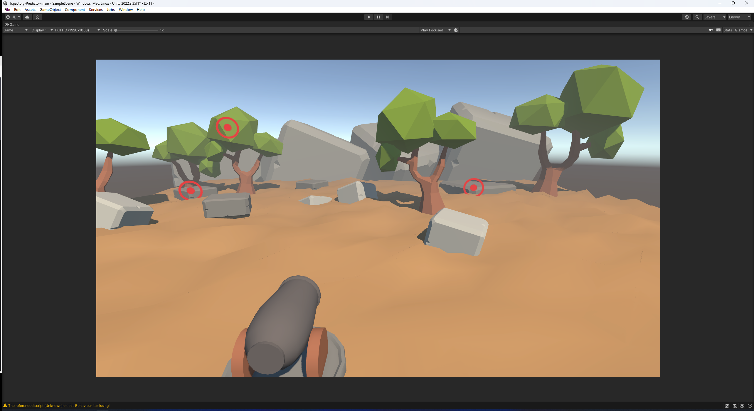
Cannon!!!!
rhodeskesi

Slide 3

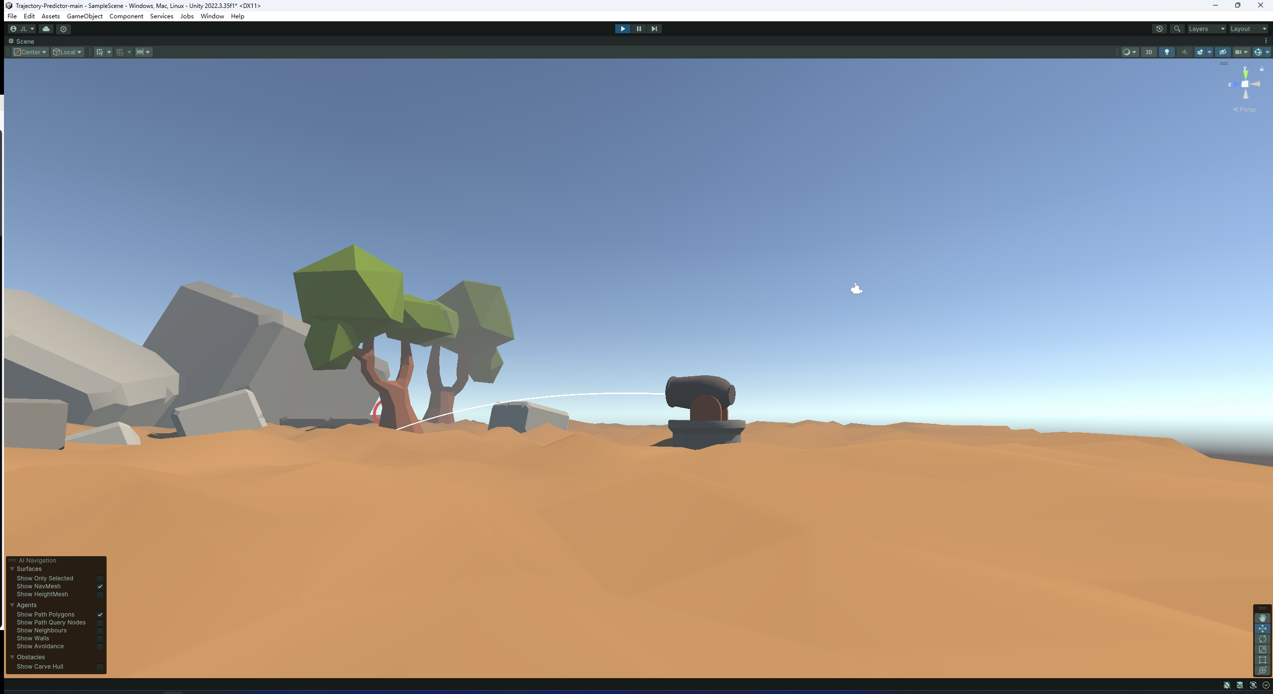
Ewenki
Last Reindeer Tribal In China
rhodeskesi
Less than 200
Hunting, herding reindeer
30k to 40k
Tourism, herding

Slide 4
Game Story
rhodeskesi
In role of a journalist to interview this China's last reindeer tribe
Enjoy stories about the Evenki people, Follow an Evenki guide to make and roasting meat by the campfire, partake in hunting, and witness the history of Evenki people, experience the ethereal feeling of the wilderness
Encounter the various challenges of surviving in the extreme cold wilderness
After completing the interview, the journalist will showcase the experience to the audience. Players, having gone through the entire journey, will transform into this journalist in real life, sharing the stories of the Evenki people

Slide 5
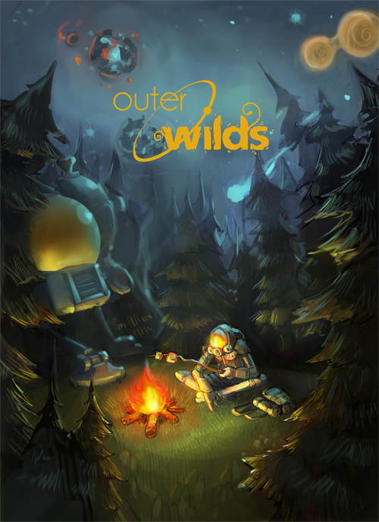
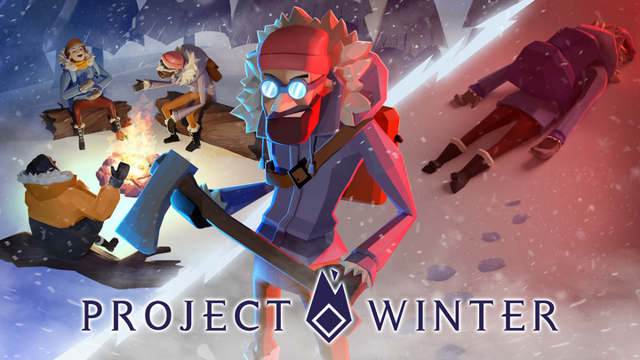
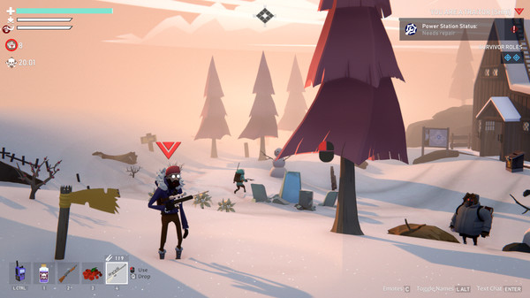
Basic design
rhodeskesi
Single Player
Narrative Adventure
PC/Console

Slide 6
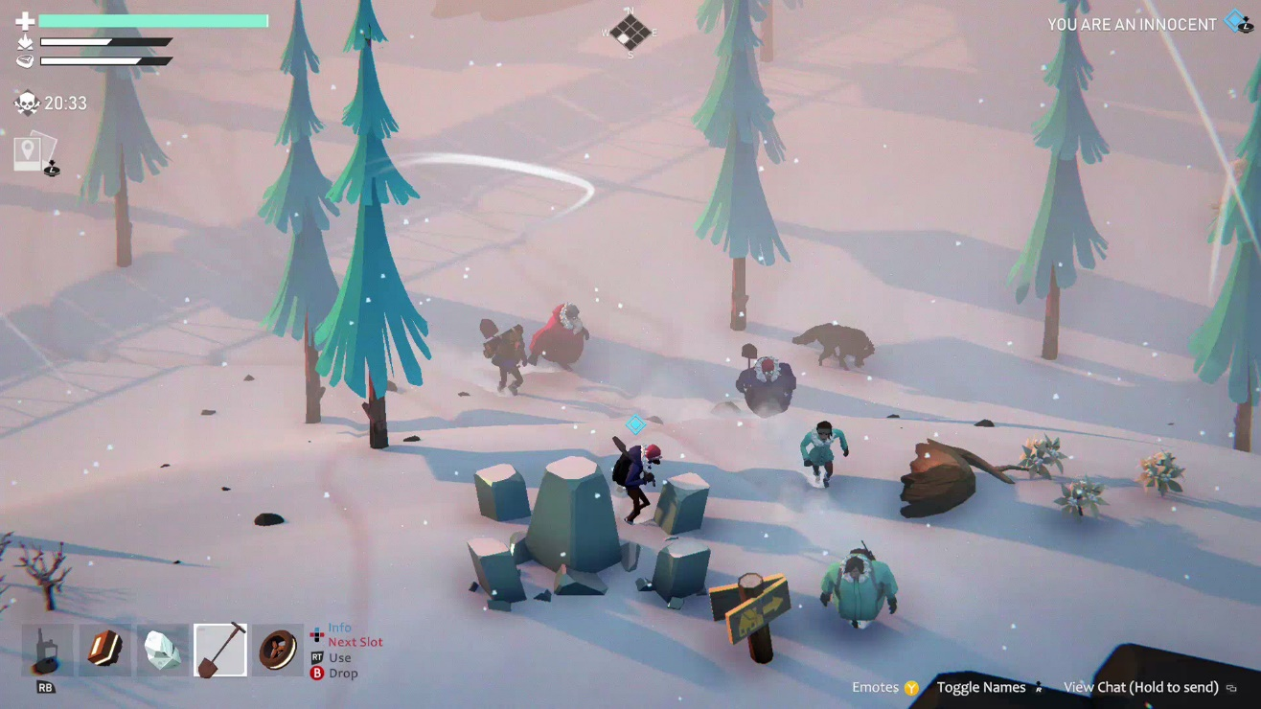
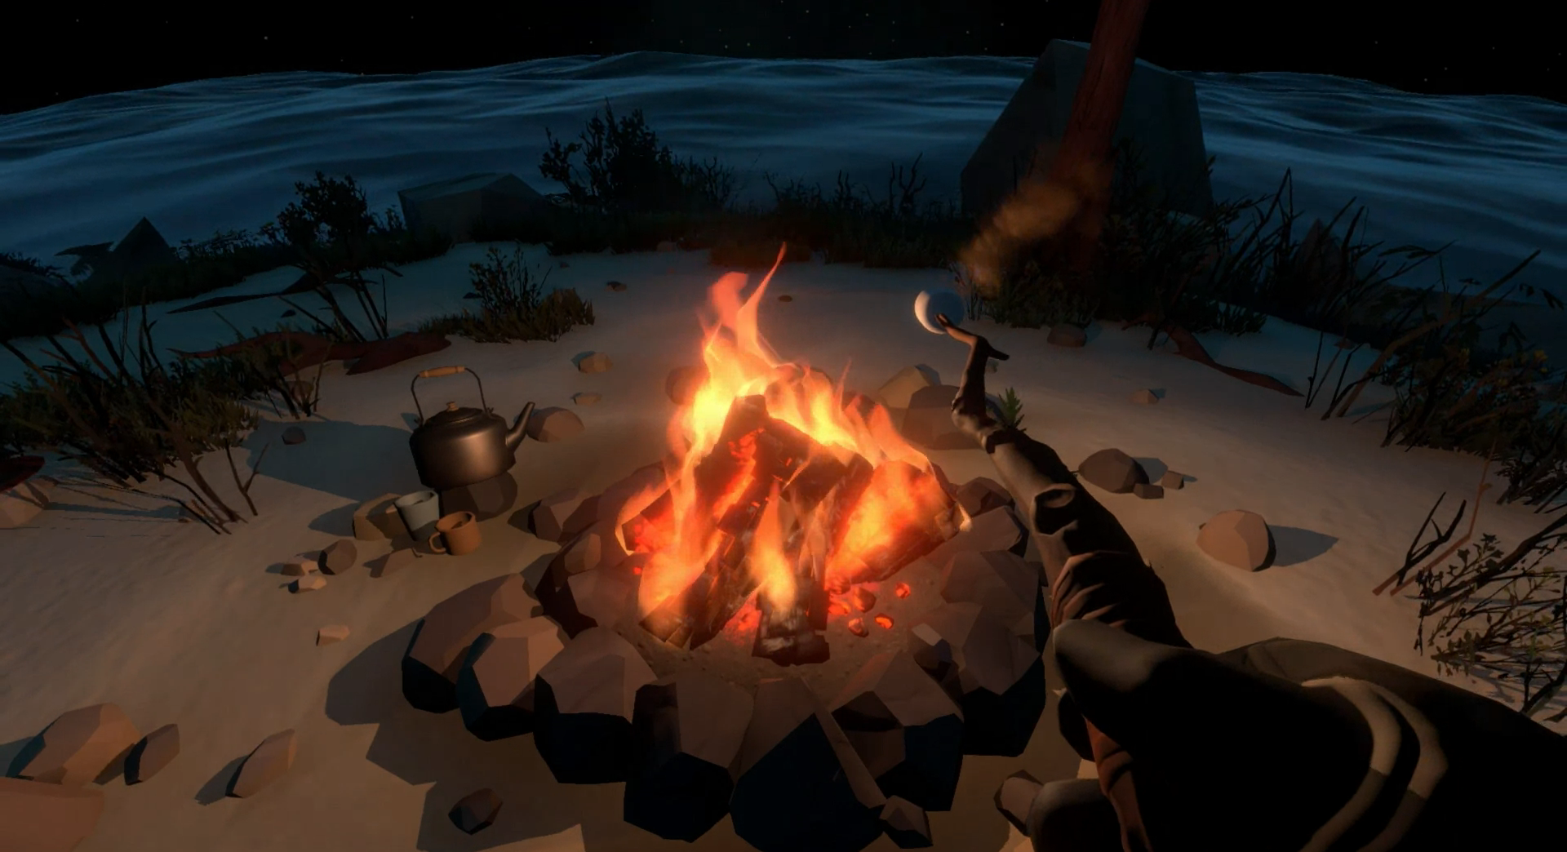
Basic design
rhodeskesi
2.5D third person or 3D first person

Slide 7
Game Experience
Through storytelling, to explore and engage in dialogues to understand the life and culture of the Evenki people.
Immersive environment, Interactive Activities(Campfire BBQ)
Help players relax and enjoy a soothing adventure, providing a warm world in this stressful modern life.

Slide 8
NEED!
rhodeskesi
1 Narrative Designer
1-2 Level Designer & Developer
1 Core Programmer
1 3D Modeler/Artist
1 Project Manager & Tester
1 Sound Designer

Slide 9


Thanks For Watching
CITY OF SCIENCE AND TECHNOLOGY

Slide 10
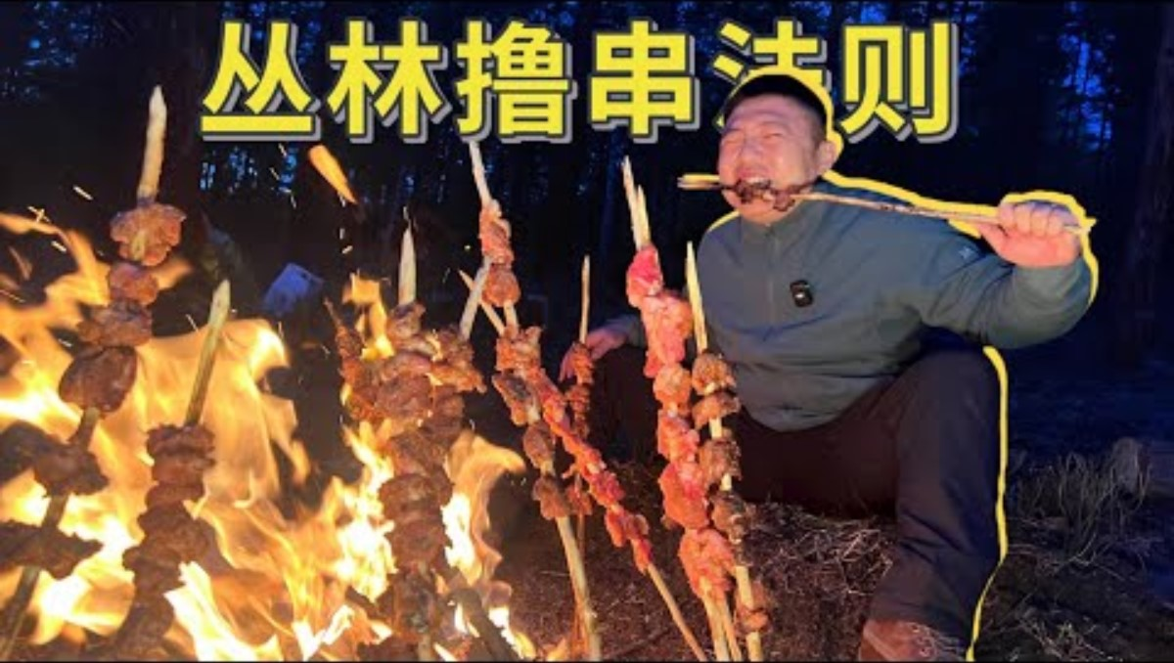
The Real Interview

